Slide 1
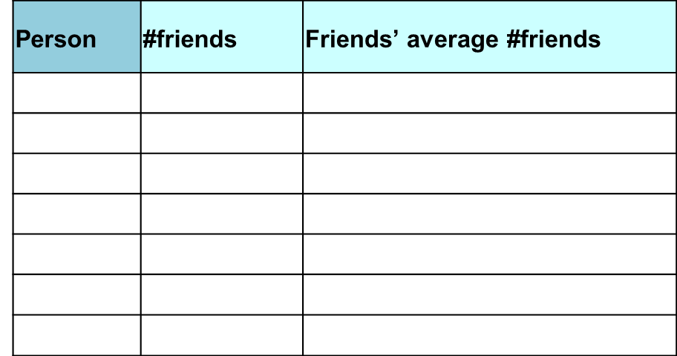
Friendship paradox
Sociologist Scott Feld showed that most people have fewer friends, on average, than their friends have
7
6
1
5
4
2
3

